Slide 1
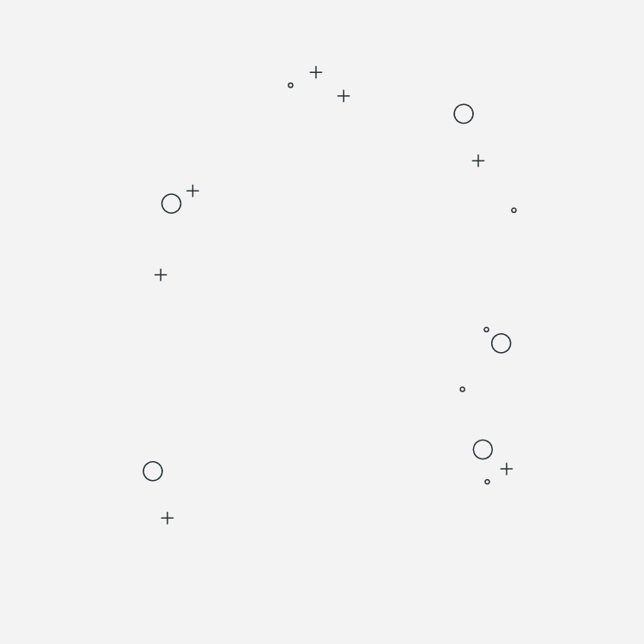
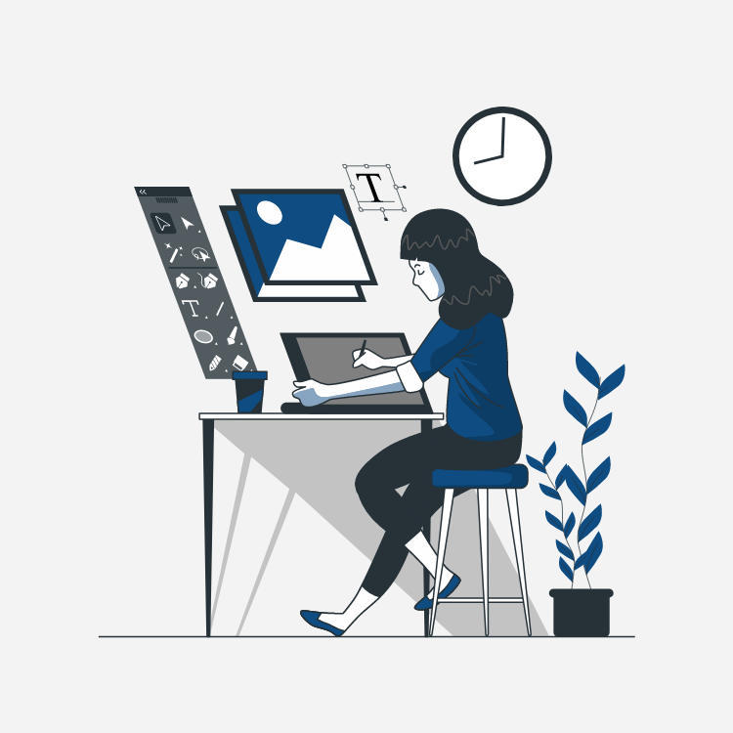
Maquettage
Or Mockup?
What is it and how to do it!

Slide 2
01. What is “Maquettage”
04. “Maquette” or Mock-up
02. UI / UX
05. Prototype
03. Zoning & Wireframing
06. Solutions
What could it be?
Bring colors to your Black and white design
User Interface & User Experience
It’s Alive! It’s Aliiiiive!!!!
Making the basic structure of your design
The task is easier with the right tools.

Slide 3
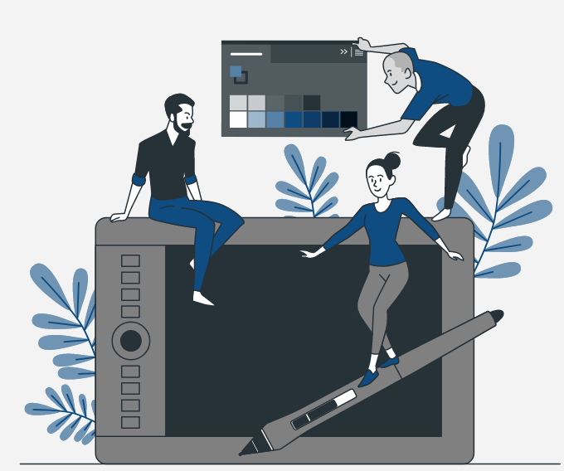
“Maquettage”
“Maquettage” or Mock-up is a process of graphically concretizing the interface of a digital product (website, software, application, etc.).
It encompasses three very distinct but often confused phases: the wireframe, the mock-up and the prototype. These three phases each have a different role but just as important to achieve a graphically pleasant and technically feasible result.

Slide 4
Graphic Charter
Is a guide, a set of rules that explains the visual elements of your brand. This guide will be part of the important strategic documents for you.
It encompasses three elements: the Logo, the Colors and the Typography. You can add more information about the company like their Values, Mission, Voice, Tone, Personality…etc.

Slide 5
Mockup Stages
00
Zoning
02
Mockup
04
Fidelity
Sketching
01
Wireframing
03
Prototype

Slide 6

What is difference between UI and UX design ?
UI (User interface)
It includes web app layout, graphic elements, images, videos, color theory, typography, etc. It mainly gives attractive looks to your product.
UX (User experience)
UX design services are for understanding the user's journey, their needs, and requirements and converting it into a website or application. It starts with what problems are coming for the user and ends on a prototype. This is for understating a target audience and for difficulties of present users’ flows.

Slide 7
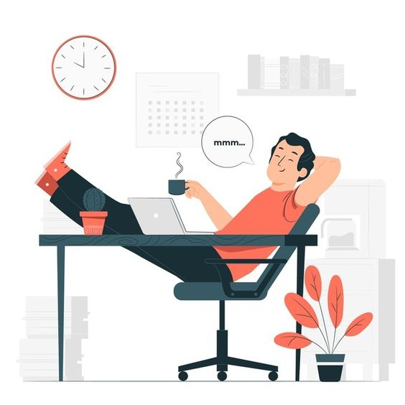
Ergonomic
Ergonomics (or ‘human factors’ as it is referred to in North America) is a branch of science that aims to learn about human abilities and limitations, and then apply this learning to improve people’s interaction with products, systems and environments.
Ergonomics aims to improve workspaces and environments to minimise risk of injury or harm. So as technologies change, so too does the need to ensure that the tools we access for work, rest and play are designed for our body’s requirements.

Slide 8
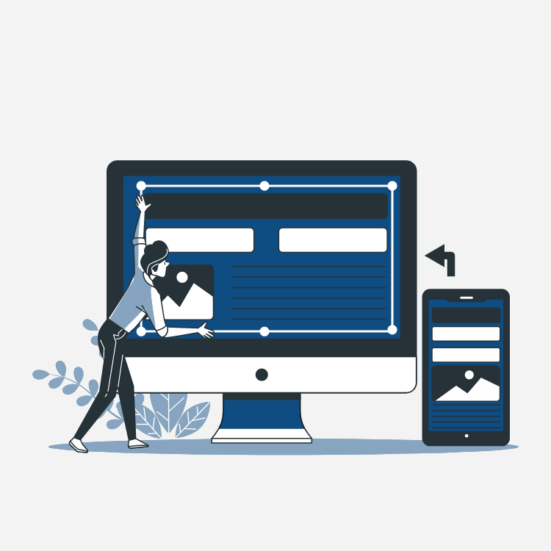
What is responsive design?
Responsive web design, also called RWD
design, describes a modern web design approach that allows websites and pages to render (or display) on all devices and screen sizes by automatically adapting to the screen, whether it’s a desktop, laptop, tablet, or smartphone.

Slide 9
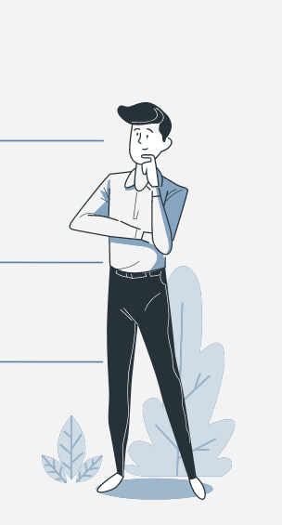
ZONING DEFINITION
Zoning is a rough plan of what the future web page will be like. Blocks are used to determine where the content and functionality will be located.

Slide 10
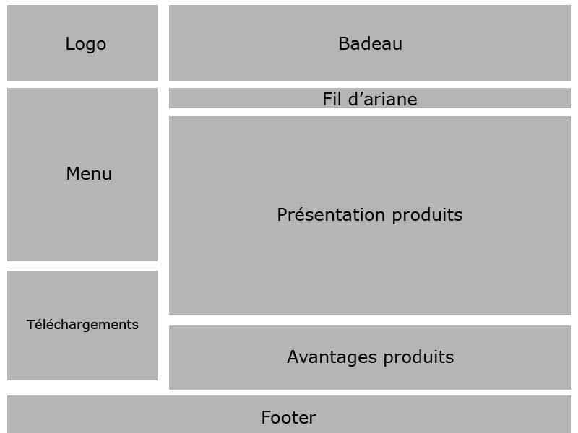
Example :

Slide 11
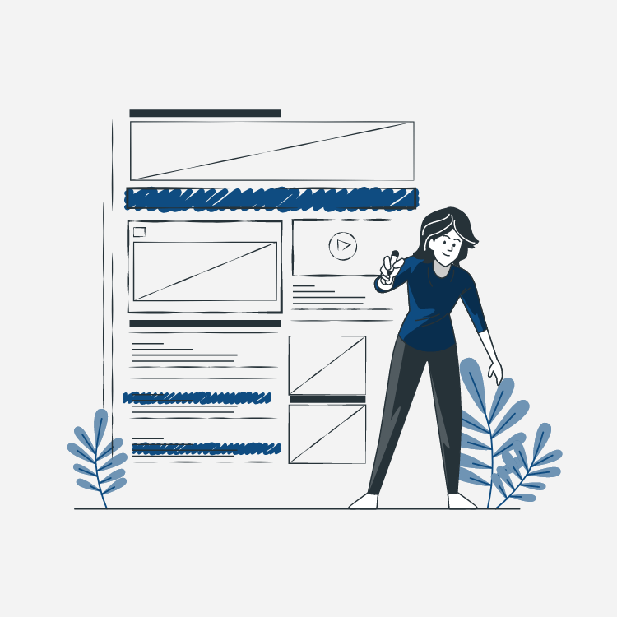
Wireframe
What is wireframe?
Why use wireframe?

Slide 12
”
WIREFRAME DEFINITION
“A wireframe is a schematic or blueprint that is useful for helping you, your programmers and designers think and communicate about the structure of the software or website you're building.”

Slide 13
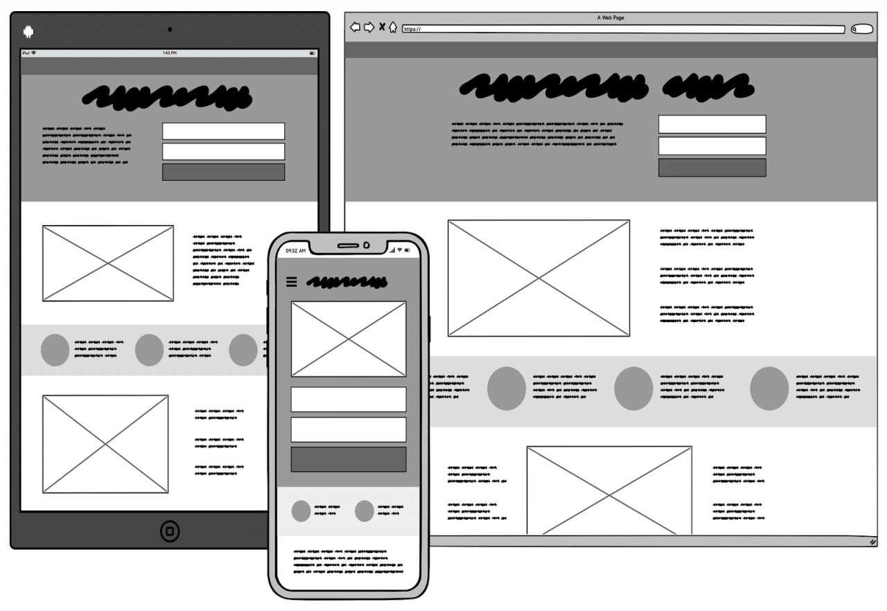

Slide 14
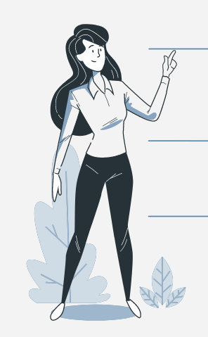
Reasons for using wireframe
1.Wireframe help get your message across
3.Wireframe result in easy to use software and websites
2.Wireframe help you nail down the interface
4.Wireframe save you time and adjustment work later

Slide 15
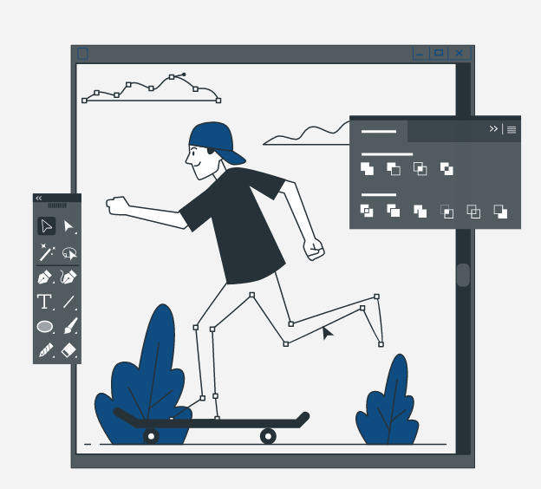
Mock-up
This is the second step for designers. A mockup is a more refined version of the wireframe. Here a mockup may include colors, images, and typography.
The mockup shows precisely how your application will look. The mockup is an animated model of an app, but it doesn’t perform any real functions.

Slide 16
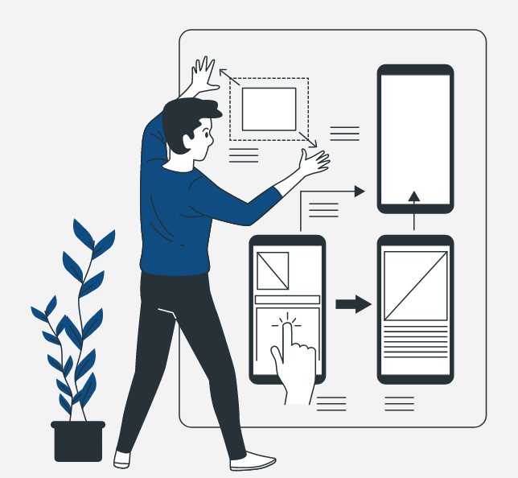
Prototyping
Prototypes are a close replica of what the end result of a product will look like, usually without code. They incorporate most of the final UI design and interaction that the finished product will have.
Also, it allows you to explore your ideas and show the intention behind a feature or the overall design concept to users before investing time and money into development.

Slide 17
Solutions
 | Figma | Adobe XD | Sketch
Pricing | FREEMIUM | $9.99/month | $9/Editor/month
Devices | WEB/DESKTOP | DESKTOP | WEB/DESKTOP
Community | Epic | Great | Good

Slide 18
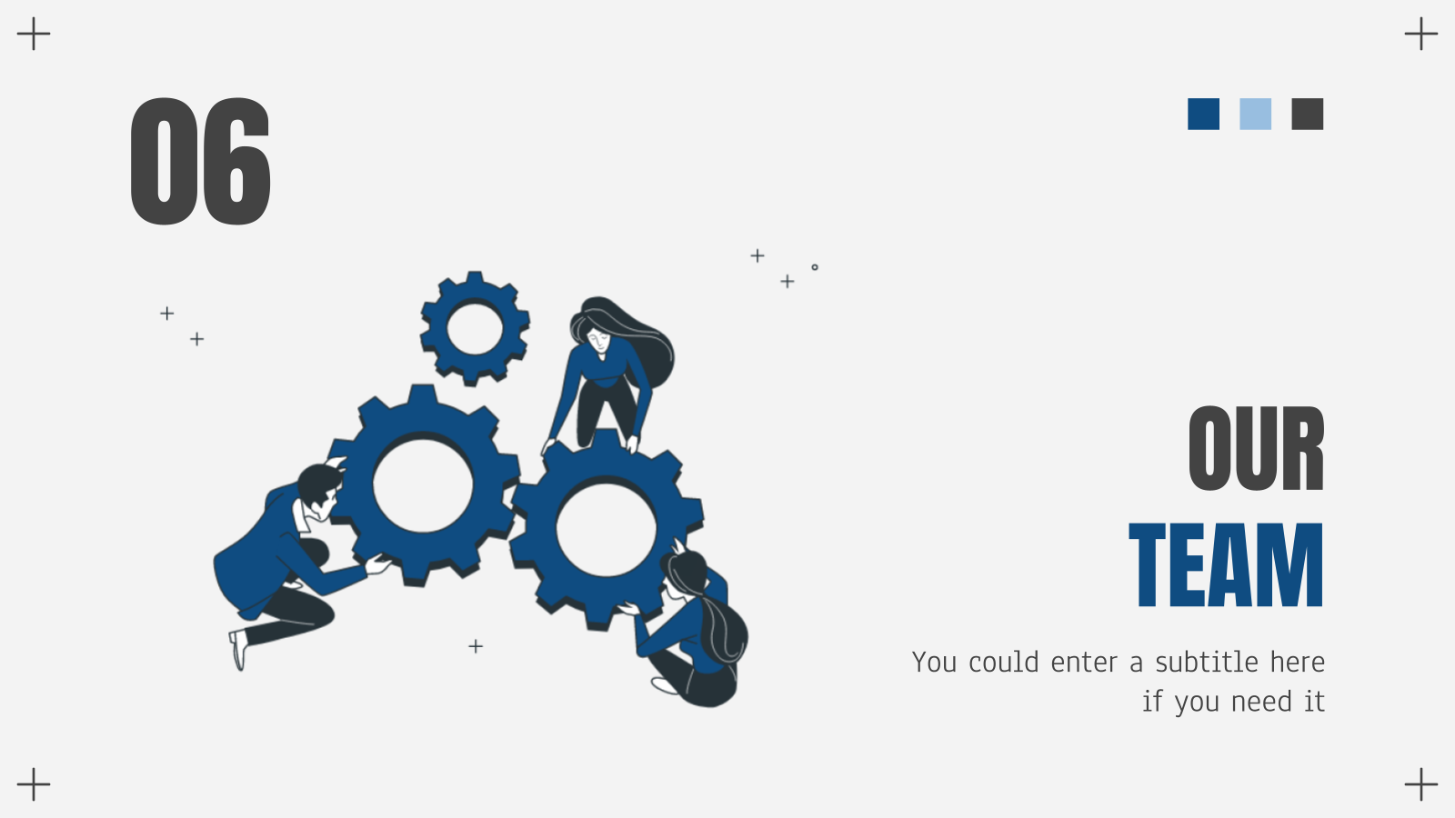
Salma Elmrabet
Hala Ziani
Mohammed-Aymen Benadra

Slide 19
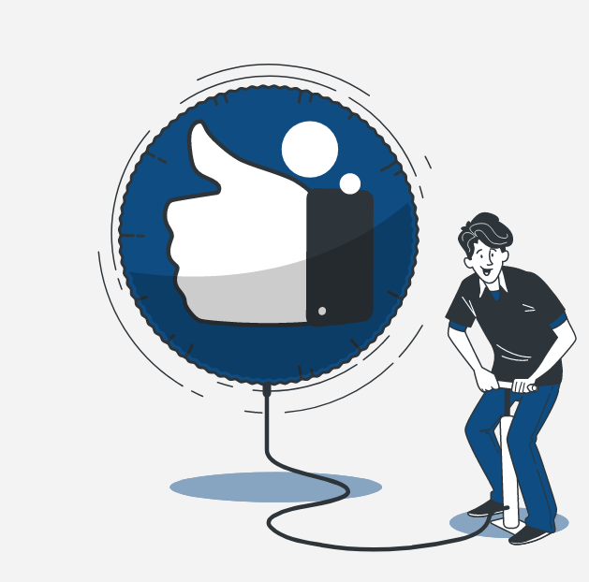
THANKS!
Do you have any questions?
Google it or ask Hala…
Especially You!

